Slide 1

The Problem
A Love Worth Work Company
$150B+
lost annually to preventable no-shows
Your Care.
36%
of US adults have limited health literacy
All in One Place.
$300B+
wasted on medication non-adherence yearly
AI-powered health navigation, education,
and care coordination — built for patients,
designed for providers.
3–5
providers the average chronic patient coordinates across
ACE Care Hub™ · Patent Pending · Founded 2025
ACE Care Hub™ · Confidential · For authorized distribution only

Slide 2





THE SOLUTION
One Platform. Five Capabilities.
ACE Care Hub™ is an AI-powered health navigation, education, and care coordination platform that helps patients understand their care, organize their health information, and navigate the healthcare system with confidence — while giving providers measurable, reportable patient engagement outcomes.
Understand
Your Care
Organize
Your Health
Prepare
for Every Visit
Track
What Matters
Access
Support
Plain-language AI health education and medical term interpretation
Centralized records: conditions, meds, visits, documents
AI-guided question generation and appointment preparation
Symptom logging, medication adherence, wellness patterns
Health advocates, peer support, family sessions, care reviews
2

Slide 3
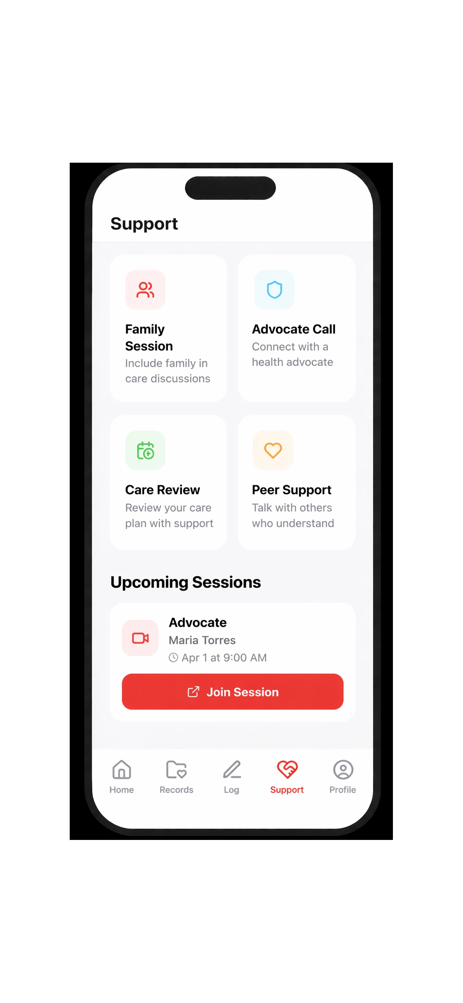
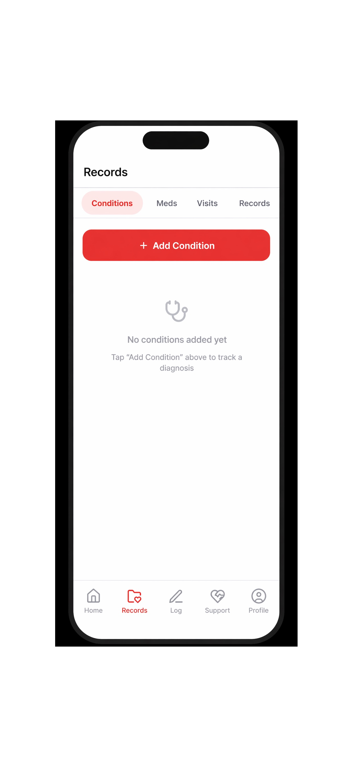
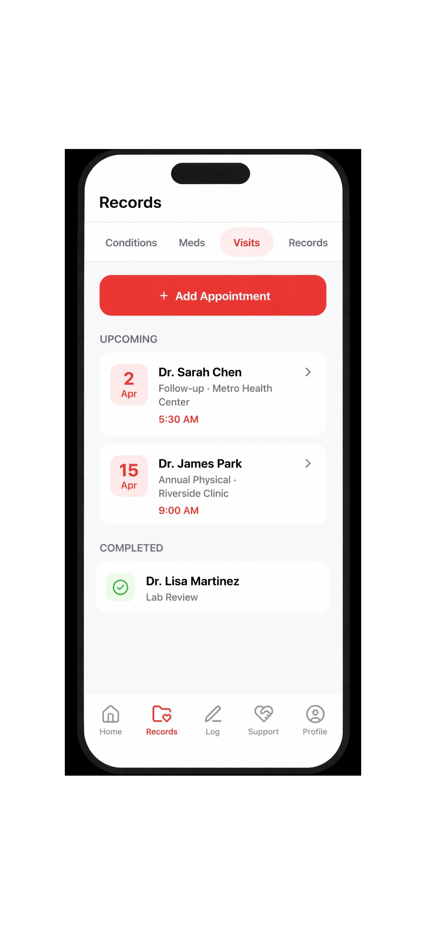
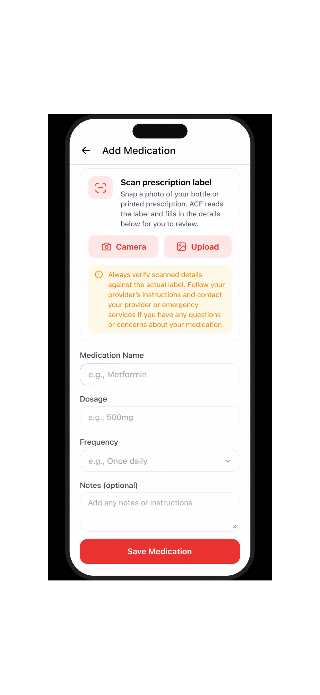
THE PRODUCT
Built for Real-Life Care Navigation
Support Hub
Symptom Logger
Med Manager
Appointments
Family sessions, advocates, peer support & care reviews in one tap
Structured severity tracking with trigger and pattern identification
AI-powered OCR prescription capture with adherence tracking
Visit tracking, prep guides, and AI-generated provider questions
3

Slide 4
MARKET OPPORTUNITY
A $50B+ Problem. No Integrated Solution.
$150B+
36%
$300B
14,000+
Annual no-show cost
Limited health literacy
Medication non-adherence
FQHCs & health centers
US healthcare system
US adult population
Estimated annual cost
Primary target segment
MARKET SIZING
TAM — Total Addressable Market
$47B
Digital patient engagement, health navigation, and care coordination market (2025 est.)
SAM — Serviceable Addressable Market
$8.2B
US FQHCs, independent specialty practices, ACOs, and community health systems
SOM — Serviceable Obtainable Market (Yr 1–3)
$120M
Target: 3–5% of SAM through B2B pilot expansion and ACO contracting
4

Slide 5



BUSINESS MODEL
B2B SaaS — Institutional Licensing with Measurable ROI
REVENUE STREAMS
REVENUE PROJECTION
FQHC & Clinic Pilots
$500–$2,000 / 90-day pilot
Entry-level paid pilot with outcome reporting — converts to annual license
Annual Institutional License
$15,000–$100,000+ / year
Per-organization SaaS license scaled to patient volume and feature set
White-Label / ACO Licensing
$50,000–$500,000+ / year
Non-dilutive first: NIH SBIR ($150K–$300K) + HRSA grants available pre-revenue
Co-branded deployment for ACOs, Medicare Advantage plans, health systems
5

Slide 6
CLINICAL OUTCOMES & ROI
Why Providers Pay: Measurable Financial Impact
ACE Care Hub creates direct, quantifiable value for every buying organization:
No-Show Reduction
30-Day Readmission Reduction
15–25%
$15K–$30K/yr
10–20%
$200K–$500K/yr
per 500 patients
per hospital
CG-CAHPS scheduling domain
CMS HRRP — avoids Medicare penalty
HCAHPS Score Improvement
PAM Score Advancement
+5 points
Up to 2% DRG bonus
1 level / 90 days
8–21% utilization
retained annually
reduction projected
Value-Based Purchasing — direct CMS link
Gold standard patient engagement metric
6

Slide 7


TARGET PARTNERS
Who We Serve — Priority B2B Segments
PRIORITY #1
PRIORITY #2
FQHCs
Specialty Practices
Contract: $15K–$60K · Sales cycle: 1–3 months
Contract: $5K–$25K · Sales cycle: 2–6 weeks
Federal mandate for patient engagement tools. Mission-aligned, active HRSA budgets, fast procurement. 1,400+ sites nationwide.
Endocrinology, cardiology, oncology — highest no-show and patient navigation burden. Fastest sales cycle.
PRIORITY #3
PRIORITY #4
ACOs & Value-Based Care
Medicare Advantage Plans
Contract: $50K–$250K · Sales cycle: 2–5 months
Contract: $100K–$1M+ · Sales cycle: 4–9 months
HEDIS metric improvement drives direct ROI. Accountable for readmissions and patient activation scores.
Star rating improvement and member engagement tools. White-label licensing for member benefit delivery.
7

Slide 8





TRACTION & IP
Protected IP. Active Outreach. Pre-Revenue.
Provisional Patent Filed
ITU Trademark in Progress
Copyright in Progress
USPTO — ACE-PROV-001
Classes 042 + 044
3 registrations · 20+ works
Working App Built
B2B Outreach Active
Accelerators Applied
iOS + Android · 6 core modules
FQHCs, ACOs, clinics
StartUp Health · Rock Health
Current pre-money valuation range:
$500K – $1.5M pre-revenue · $1.5M – $3.5M on first signed LOI or pilot · $3M – $8M at $50K–$150K ARR
8

Slide 9

THE ASK
Raising $250K–$500K Pre-Seed
$1.2M – $1.5M pre-money valuation · SAFE or convertible note
USE OF FUNDS
WHAT THIS ROUND UNLOCKS
1
3 paid pilot contracts
FQHC, specialty clinic, and ACO — 90-day outcome data generation
$50K+ ARR from first 3 pilots
2
Clinical outcome measurement
PAM license, NVS tool, no-show tracking infrastructure, outcome brief production
90-day clinical outcome dataset
3
IP and legal foundation
Non-provisional patent, C-Corp formation, attorney fees, BAA templates
Seed raise at $3M–$8M pre-money
4
Product + compliance
HIPAA infrastructure, insurance, additional feature development
2+ accelerator interviews scheduled
5
Sales and outreach
Conference attendance, accelerator fees, marketing materials
25+ investors in active pipeline
30-DAY TARGETS: 3 pilot LOIs signed · Pilot data flowing · 2 accelerator interviews · Seed deck in active circulation
9

Slide 10
FOR PROVIDERS & HEALTH SYSTEMS
Start with a 90-Day Paid Pilot
ACE Care Hub works alongside your existing EHR — no workflow replacement. We handle patient navigation, education, and engagement. You get measurable, reportable outcomes.
PILOT STRUCTURE
WHAT PROVIDERS MEASURE
Enrollment
50–150 patients. Enrolled through your existing patient list. BAA signed upfront.
Appointment no-show rate (vs. matched control group)
Patient preparedness score (pre-visit survey)
Duration
90 days. Baseline data collected Day 0. Outcome report delivered Day 90.
Medication adherence proxy (app logging completion)
Cost
$500–$2,000 flat fee. No per-seat or per-patient pricing during pilot.
Post-visit follow-up completion rate
PAM score change (patient activation baseline to 90-day)
What you get
Full ACE Care Hub access for enrolled patients + 90-day clinical outcomes report including no-show delta, PAM score change, and calculated practice ROI.
Provider satisfaction (qualitative session feedback)
Ready to pilot? Contact us: Renada Bey · info@acecarehub.com · 512-710-5572 · acecarehub.com
10

Slide 11
Let's Connect
We are actively seeking:
Clinical pilot partners (FQHCs, specialty practices, ACOs)
A Love Worth Work Company
Your Care.
All in One Place.
Pre-seed investors ($250K–$500K on $1.2M–$1.5M pre-money)
Accelerator and innovation program opportunities
ACE Care Hub™ is an AI-powered health navigation platform built to help patients understand, organize, and advocate for their care — while giving providers the measurable engagement outcomes they need.
Strategic partnerships and advisory relationships
Patent Pending
ITU Trademark in Progress
Copyright in Progress
Renada Bey
Founder & CEO, ACE Care Hub
info@acecarehub.com
512-710-5572 · acecarehub.com
11

